Slide 1

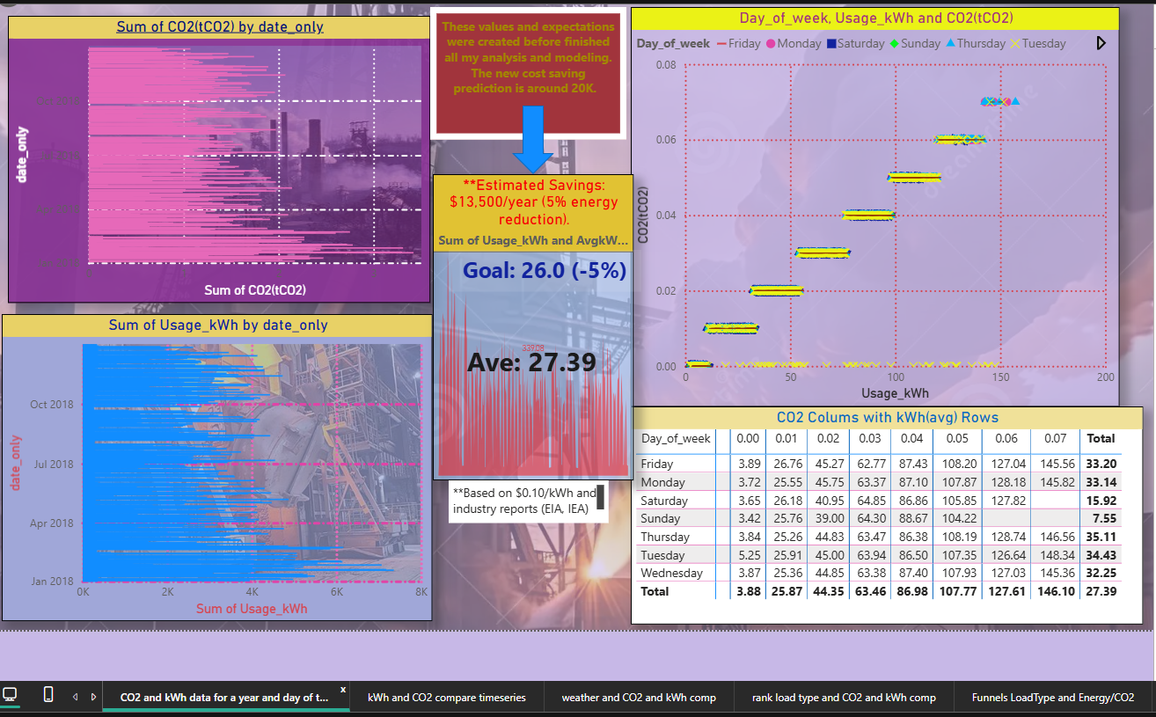
Comparisons with KPI for Energy Usage and Emissions –Report Page
Next slide shows the interactive/Cross Filtering using table

Slide 2
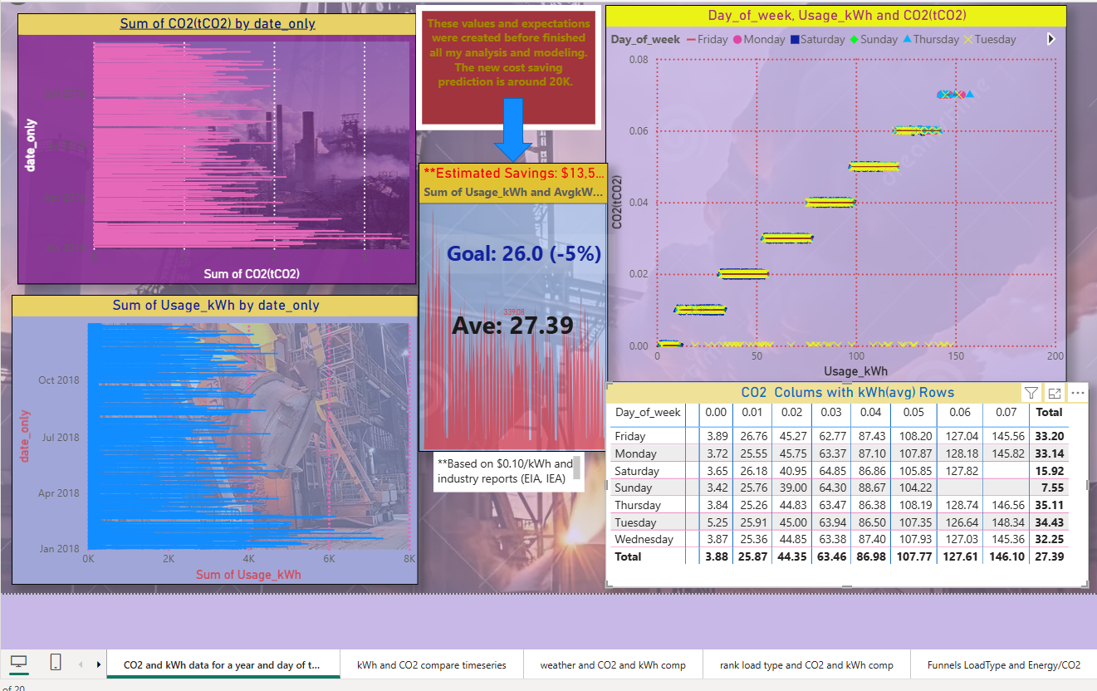
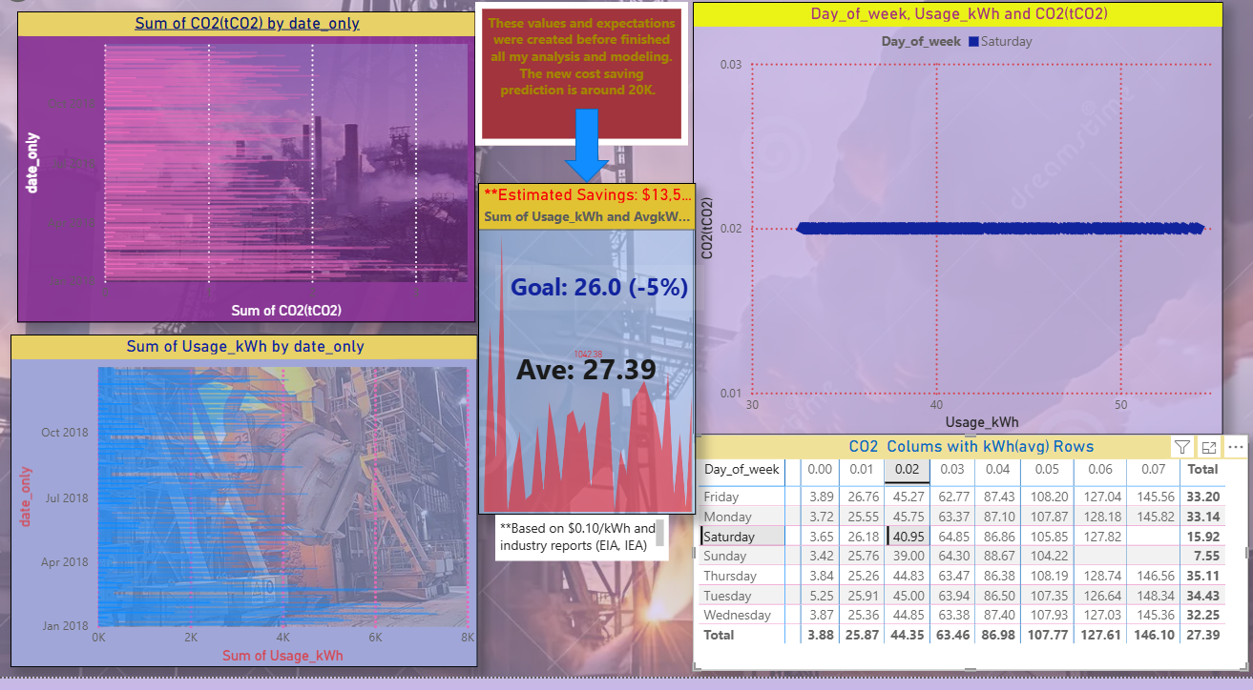
Cross-Filtering from Table to Visuals
Selecting a cell or row in a table updates the surrounding visuals (bar charts, line plots, KPIs).
This shows how users can drill into specific categories, metrics.
Selected
Row: Friday
CO2 Column at 0.02

Slide 3
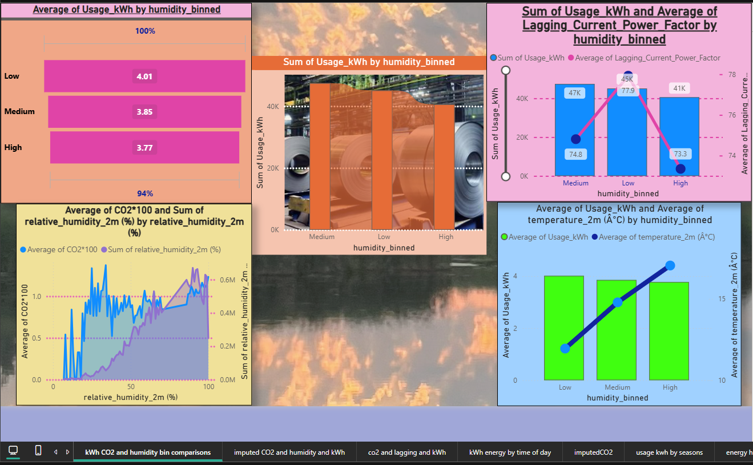
Humidity Bins Analysis with Energy and CO2 – Report Page
Next slide shows Cross-Highlighting: great for understanding the changes for each bin.

Slide 4
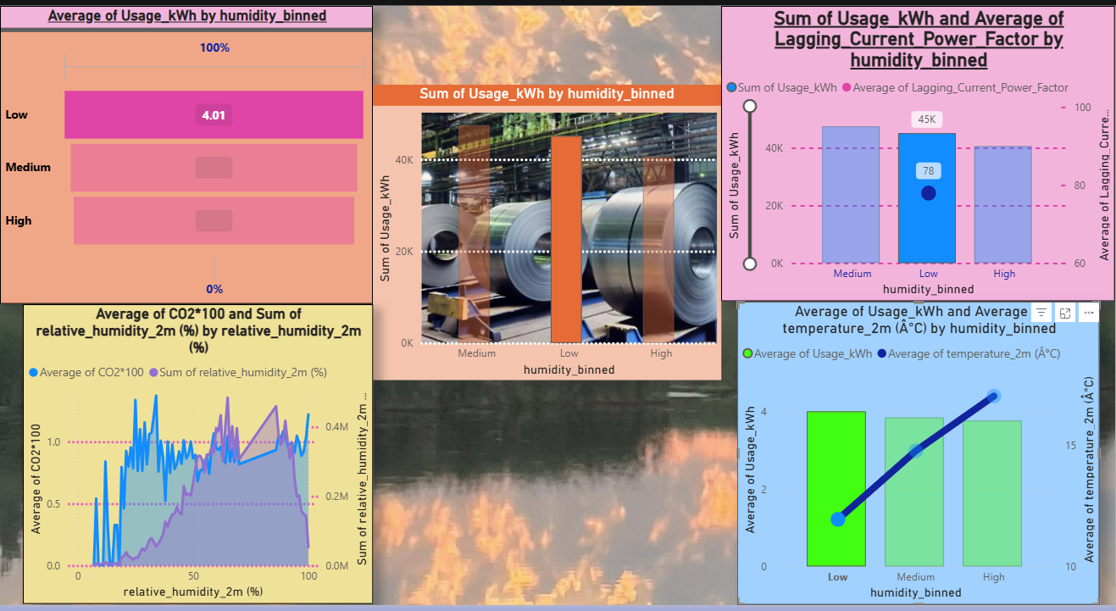
Cross-Highlighting Visuals
Selected low humidity that was showing trends with higher energy

Slide 5
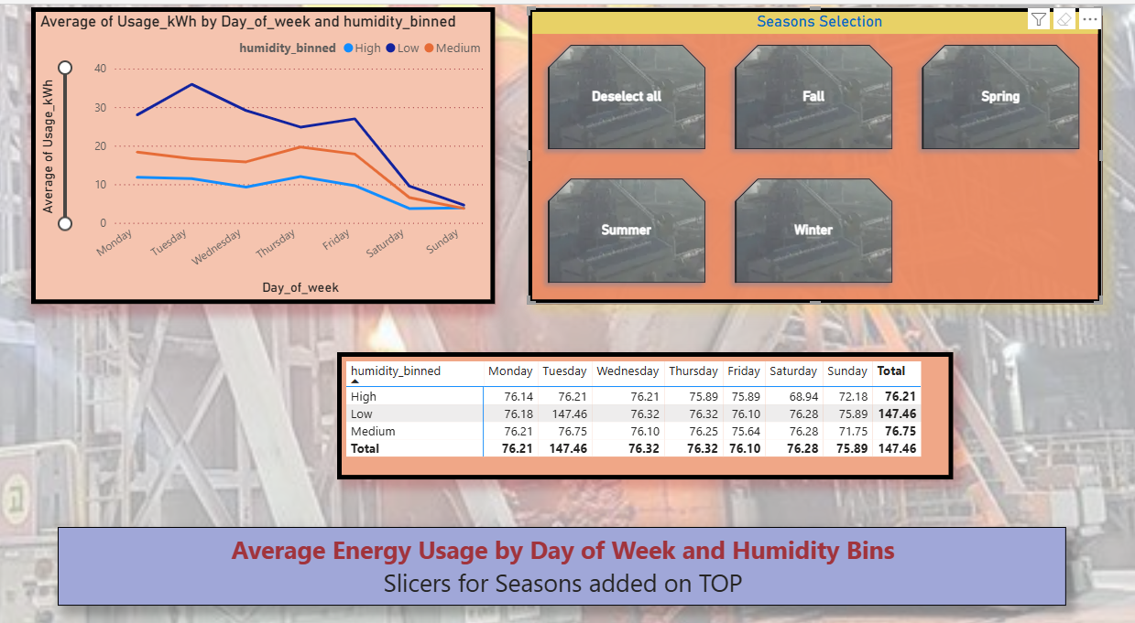
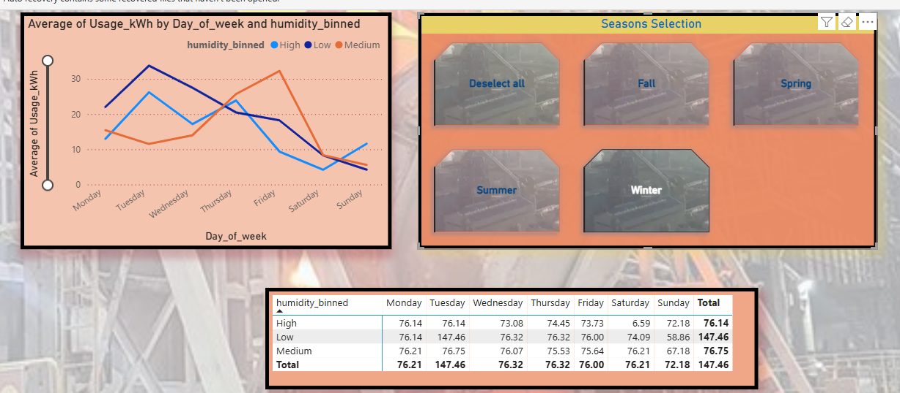
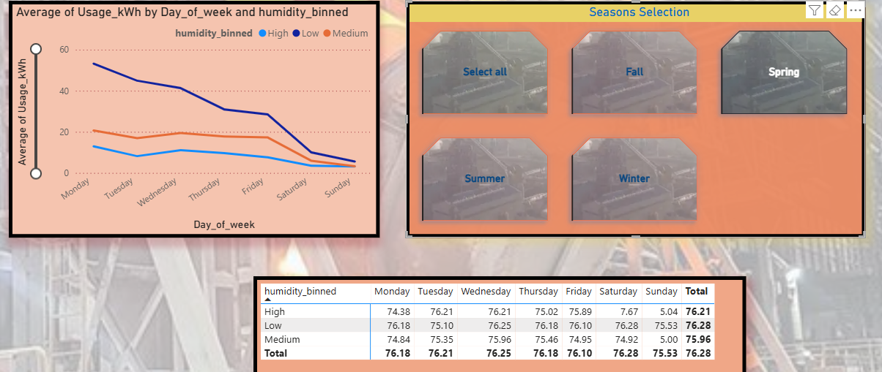
Slicer Controls Use slicers for date ranges, categories, or regions. Seasons slicers: Spring, Summer, Fall and Winter
Winter Season Selected
Spring Season Selected

Slide 6
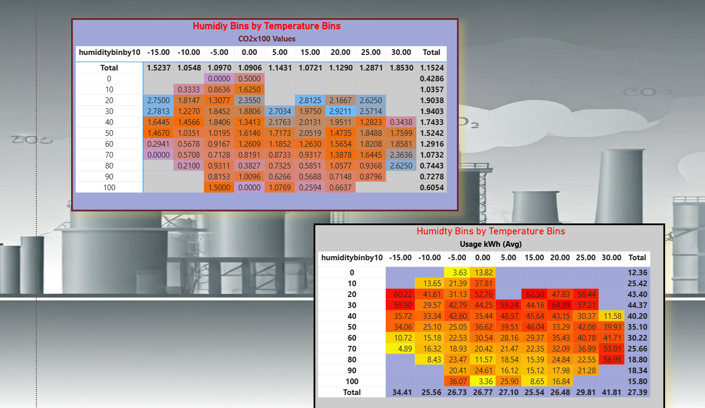
Fun with Heat Maps via PowerBI

